Slide 1
Team Two Final presentation Improving 3Blueprints.com
CS 673
SPRING 2016

Slide 2
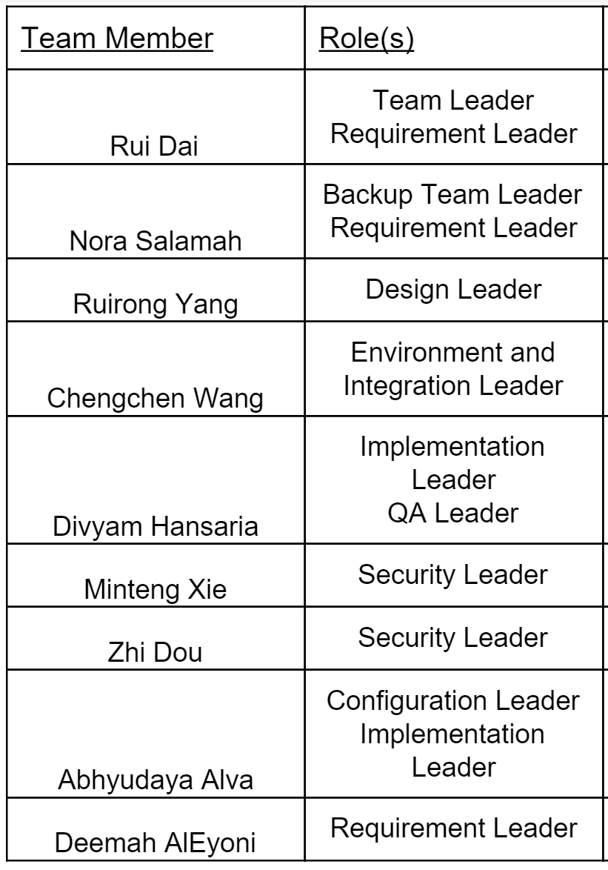
Team Overview
Weekly meetings.
Weekly reports.
Minutes of meetings report.
Slack communication.
Google Docs.

Slide 3
We divide our team into 4 sub group groups.
Nora & Zhi
Abhyudaya & Divyam
Rui & Minteng
Ruirong & Chengchen

Slide 4
Project Overview
The objective of the project is to:
Redesign the Requirements Tracker Tool in 3blueprint.com.
Fix some existing bugs.
Extend some of the essential features.
Agile methodology.

Slide 5
Iteration review
The project will go through 3 iterations:
1st iteration is due by 3/2.
Training.
Testing
2nd iteration is due by 3/29.
Fix bugs
New features
3rd & final iteration is due by 4/27.
New features

Slide 6
Project Tools
Communication:
Slack
GoogleDocs
Programming languages and tools:
Pycharm
Django
SQL
Jenkins
Version Control:
GitHub
Requirement & project status:
Pivotal Tracker

Slide 7
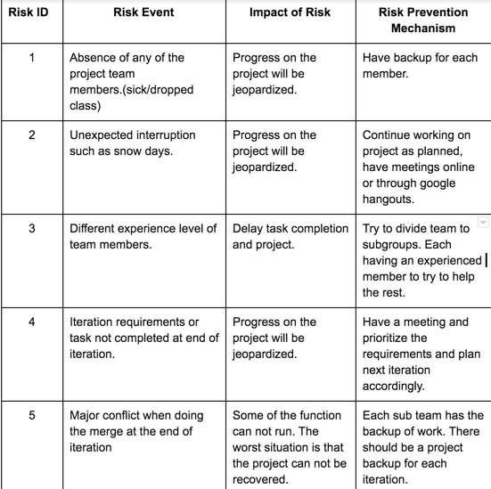
Risk Management

Slide 8
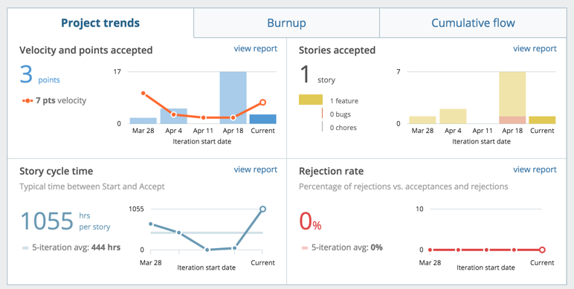

Slide 9
Lessons learned
Communication
weekly meeting is not enough, online collaboration is required. (Slack, Google Doc)
Learning in short time
understand previous code
new tools like Git, test; new method like Agile; new programming language like Django
Big team
working in sub group is efficient
Integration Issue
use Jenkins to integrate all the work

Slide 10
Requirement Analysis
Use case diagram of the system
Example of user story
Features implemented in iterations

Slide 11
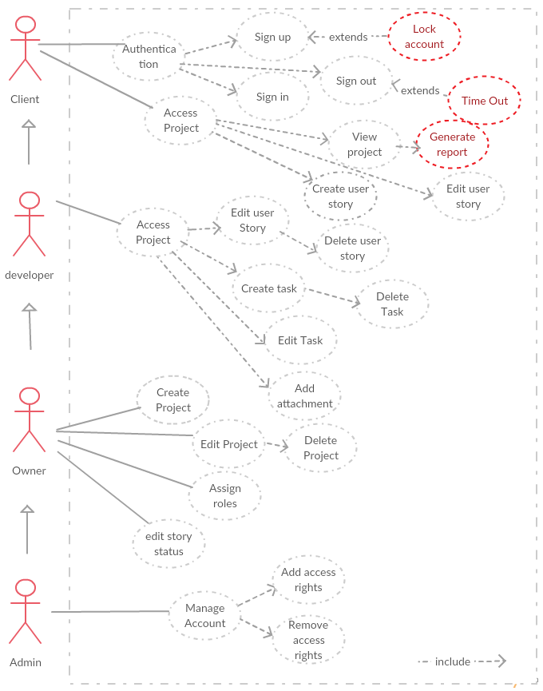
Use Case

Slide 12
user story - example
lock IP address for 3 unsuccessful login
Description:
As a user, I will not be able to login if I entered the username and password incorrectly three times. User’s IP address will be locked for 60s for next try.
Task:
Test the current selenium and unit test and make sure that any signed & valid accounts can login. (1 hour, 1 person)
Design the algorithm on how to lock the IP address(4 hours, 2 people)
Implement the function. (12 hours, 2 people)
Test selenium and unit tests for new function.(3 hours, 1 person)

Slide 13
Iteration I - Testing
Unit test
Create new user
Crete different role
Get iteration
Iteration end date is earlier than start date
Add user twice to one project
UI test
Create new user
Login as a new user
Delete existing user
Input wrong password three times
Create project name with duplicate name

Slide 14
Iteration II - Fixing bugs
No 0 or less hours for story
Start date constraint
Fix Move button when no iterations are present on the project page
Fix Move button when no iterations are present on icebox page
Fix Duplicate project title
Security issue of sign in
Generate a txt file of information of a project

Slide 15
Iteration III - New features
Add role drop down list in sign up page
Automatically logs out when page is closed
Timeout when no activity
Lock account for 3 unsuccessful login attempts
User receives email regarding changes to account
User name on account
Generate report

Slide 16
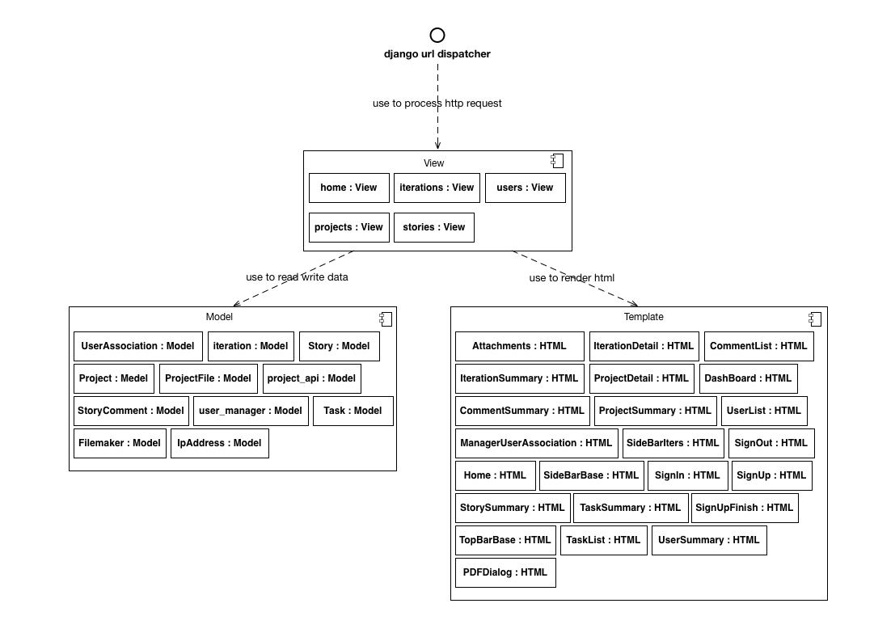
Design

Slide 17
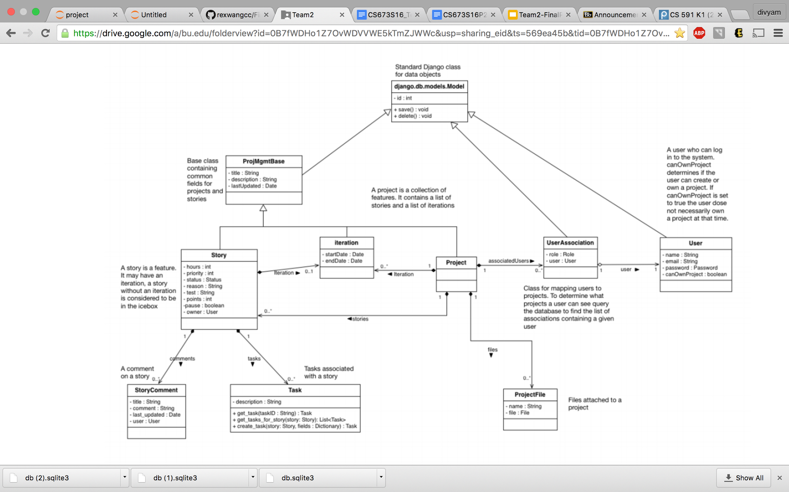
Implementation

Slide 18
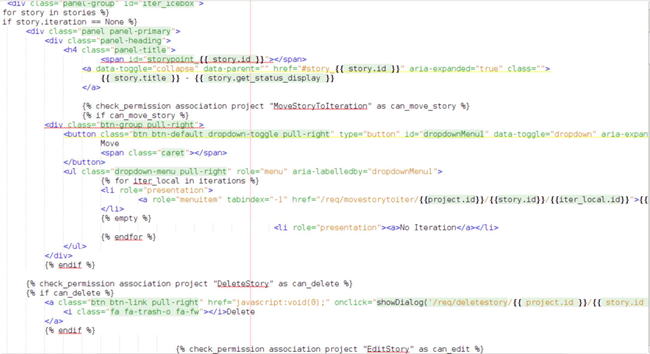
Template

Slide 19
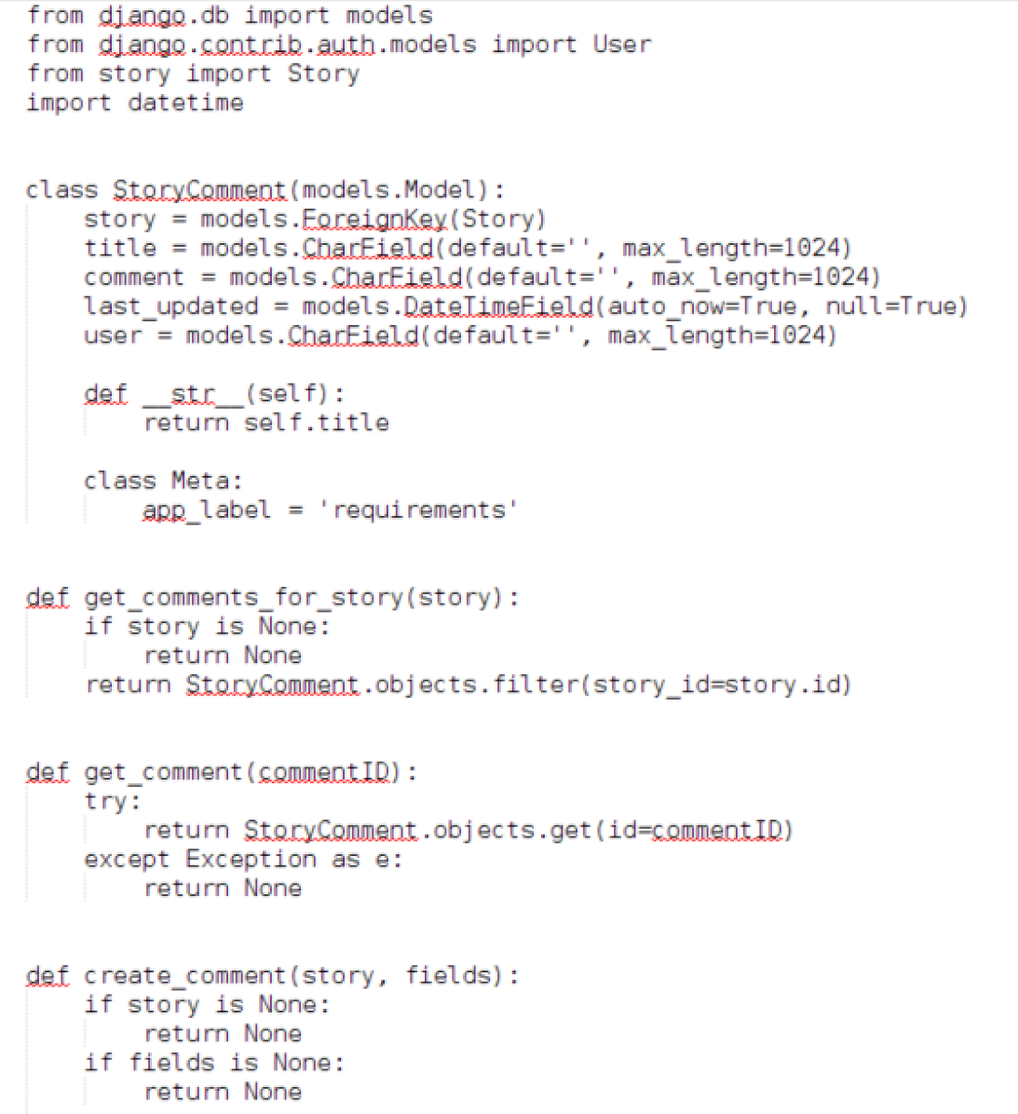
Models

Slide 20
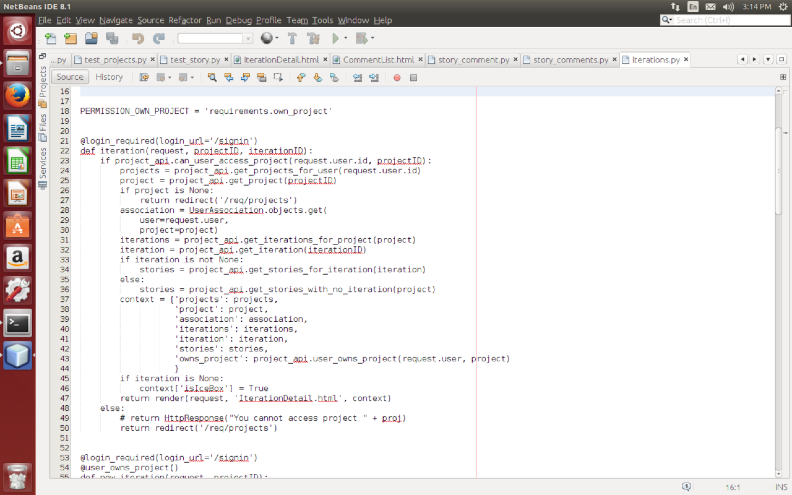
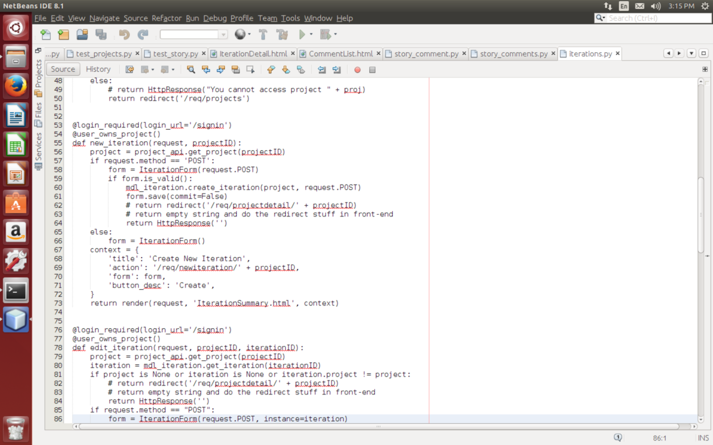
Views

Slide 21
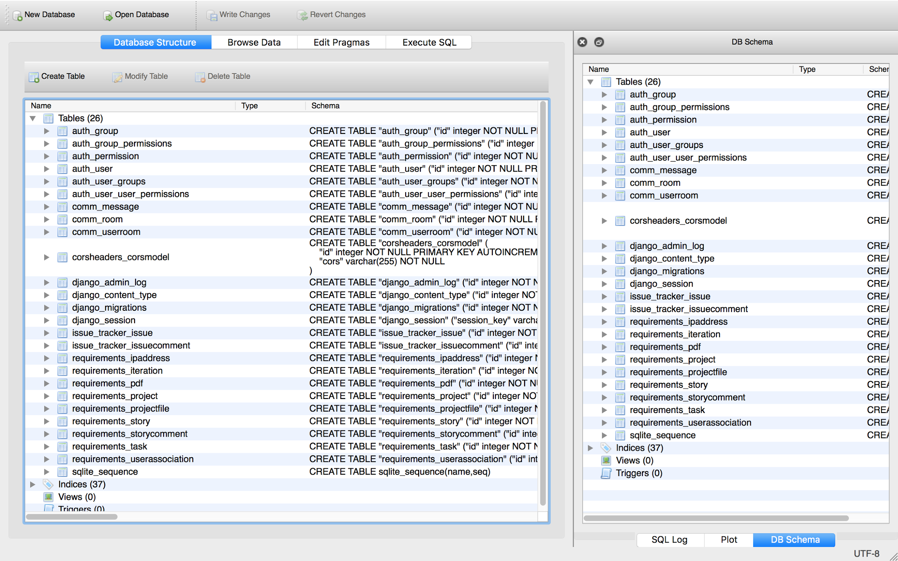
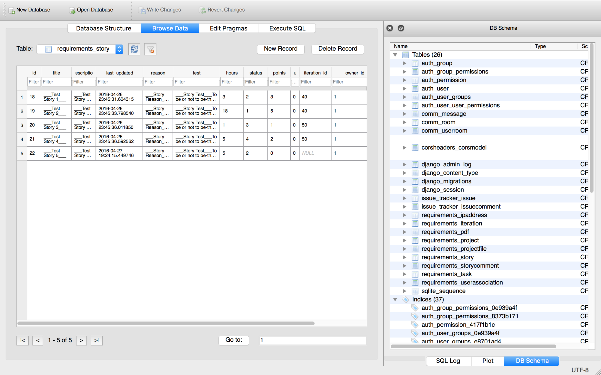
Database

Slide 22
Security process and technique
a. Security Training
b. Security Requirement
c. Security Design
d. Secure Coding
e. Security Detection/testing
f. Security Supervision

Slide 23
Security process and technique
a. Security Training
I. Common Security Issues in software development
Search and learn some common security issues in software development, and then avoid those issues as far as possible.
II. Some good links and readings
Chapter 20: security in “The django book”, “Security in django”, we share them in our team folder.

Slide 24
Security process and technique
b. Security Requirement
I. Security Requirement Definition
A user-oriented quality requirement that specifies a minimum required amount of a quality sub factor of the security quality factor.
II. User Requirement
The security requirement depends on the user requirement, developers have to find what the user need in the security aspect.

Slide 25
Security process and technique
c. Security Design
I. Data Secrecy
II. Data Integrity (Accuracy, Reliability)
Developers need to ensure the accuracy and reliability of the data in the software development.
III. System Availability
We firstly need to fix the bugs of the existing software; we don’t want to destroy the whole system. So we need to ensure the availability of the system. We use github to implement version control to maintain system availability.
IV. Exception Handling (Error Handling)

Slide 26
Security process and technique
d. Secure Coding
I. Maintain existing code
Read and learn the existing code, also fix bugs and maintain the system by secure coding.
II. Secure coding
There are many secure coding standards, guidelines and publications on the Internet. We share those links in our team folder.

Slide 27
Security process and technique
e. Security Detection/testing
I. Static Detection (security in python)
White-box analysis, structural and functional analysis
II. Dynamic Detection (security of python)
Black-box analysis, identify and address security-related issues.
III. Exception Detection (security with python)
Detect the error and exception handling of the software. Develop security-hardened python suitable for high-risk and high-security environments.

Slide 28
Security process and technique
For static analysis, we use pylint.
We also find “OWASP Python Security Project”
A2 - Broken Authentication and Session Management

Slide 29
Security process and technique
Session:
Session ID:
Length, Entropy, content
Exchange management:
Automatic Session Expiration:
Idle timeout
Absolute timeout
renewal timout

Slide 30
Security process and technique
f. Security Supervision
I. Risk Assessment
The security supervision and risk assessment need to be considered in every process of the software development. We find django-supervisor.

Slide 31
Testing
Total Number of Unit Test Cases Earlier : 42
Total Number of Unit Test Cases: 58 Pass Percentage : 100%
Total Number of UI (selenium) Test Cases Earlier : 6
Total Number of UI (selenium) Test Cases : 13 Pass Percentage: 100 %
Unit Testing:
Test_other
Test_project_api
UI Testing:
Test 0 hours
Test Authentication
Test Create User
Test Download Project Report
Test Move Iteration Error
Test Story Comment
Test User
T2 Test Authentication

Slide 32
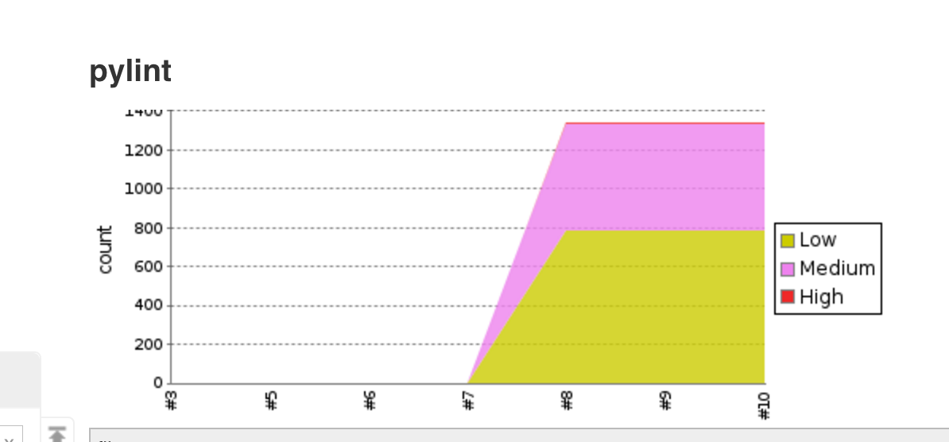
Static Code Analysis
Total Number of Lines of Code Added to the Project : 3662
Total Number of Lines Deleted From the Project : 229

Slide 33
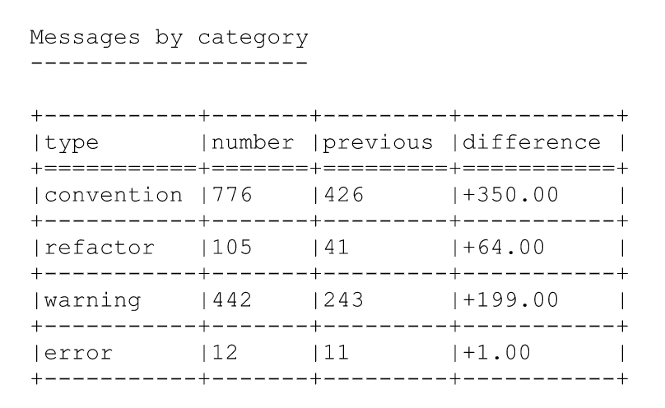
Static Code Analysis

Slide 34
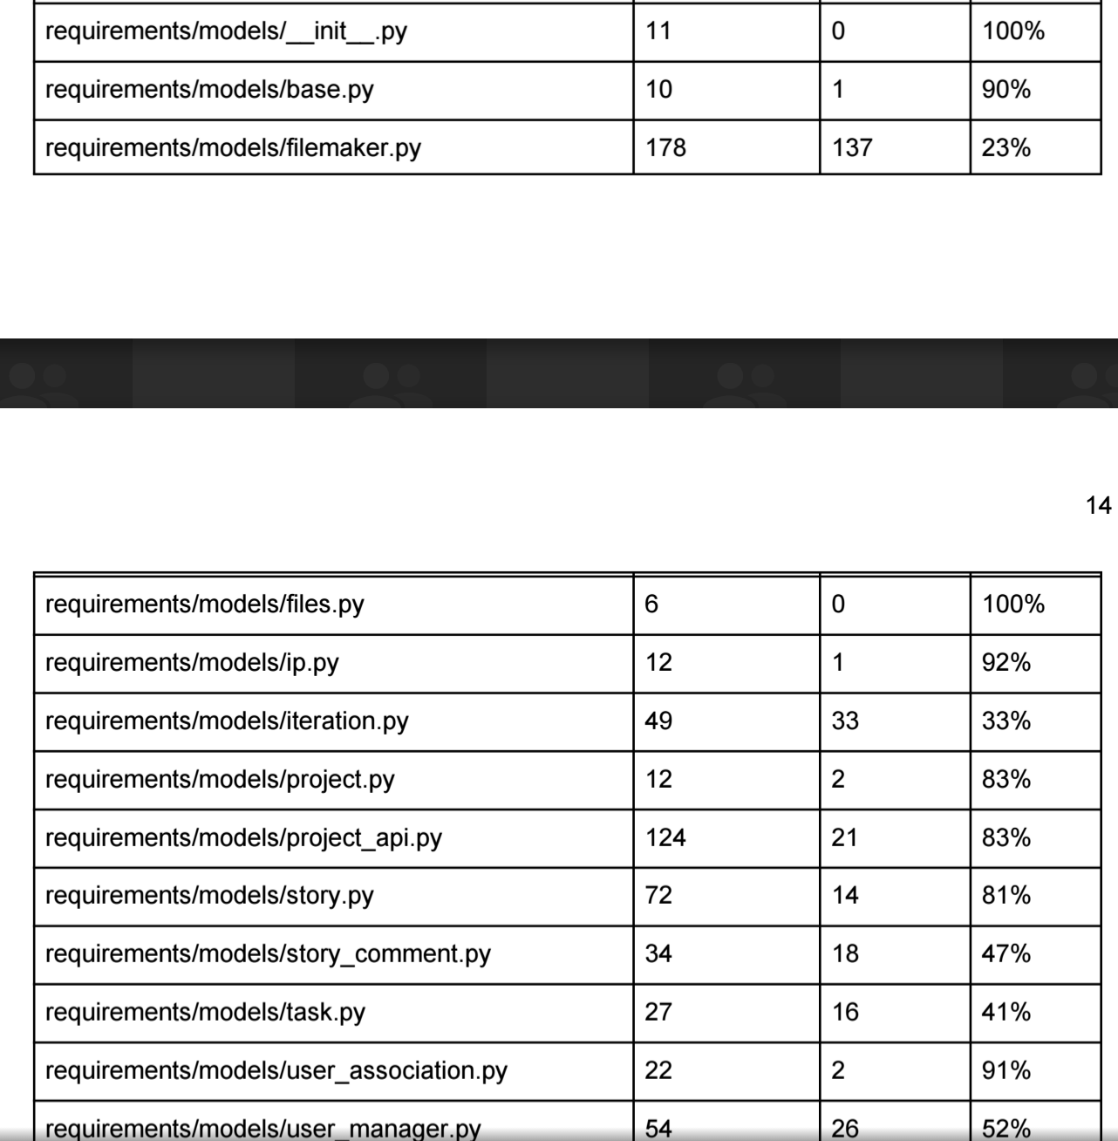
Coverage

Slide 35
Configuration and Continuous Integration
Configuration: Git
Created branch for each team and merged into master in the end.
Why Continuous Integration ?
Solves integration problems ( environment and commit issues).
Ensure that the code committed is working.
Ensure that the code committed meets the standards.
Ensure that all test cases pass.
Maintain Project in Consistent State.
Enforces individual responsibility towards commits.

Slide 36
Tools for Continuous Integration
Jenkins:
Installed Plugins:
Cobertura ( Coverage Report)
Violations ( To check for Pylint Violations )
Other Tools:
Django-jenkins (To generate Jenkins Related Coverage Report and Test Report)
Pylint Configuration (To generate Jenkins Parseable Report and Ignore )
Github Plugin (To Poll Github for code changes)

Slide 37
Demo
Group 2
Display username on comment
Move Story when no iteration present
Jenkins setup
Static code analysis using Pylint
Code coverage

Slide 38
Jenkins Demo

Slide 39
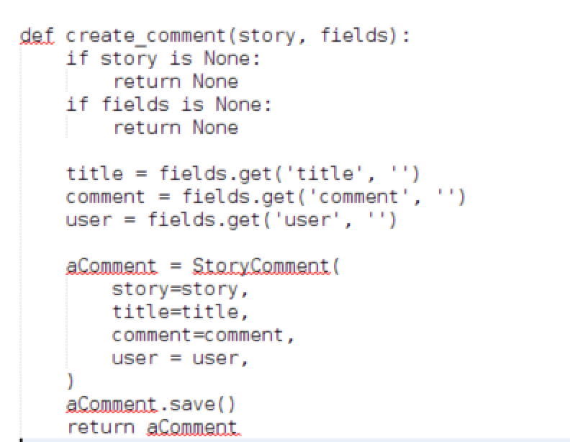
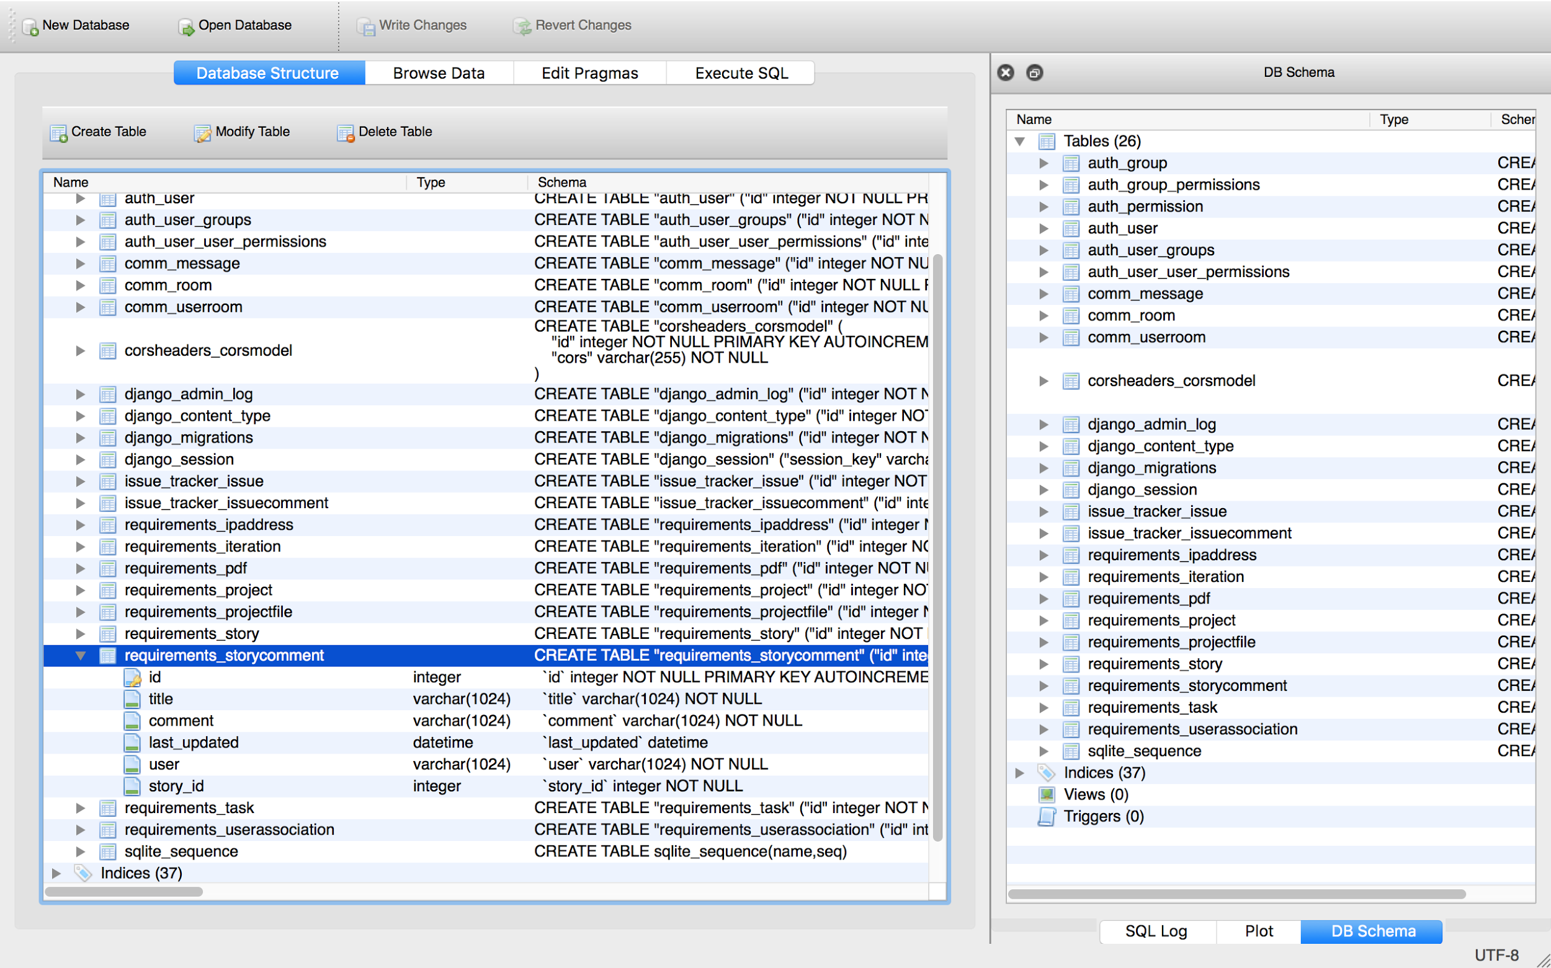
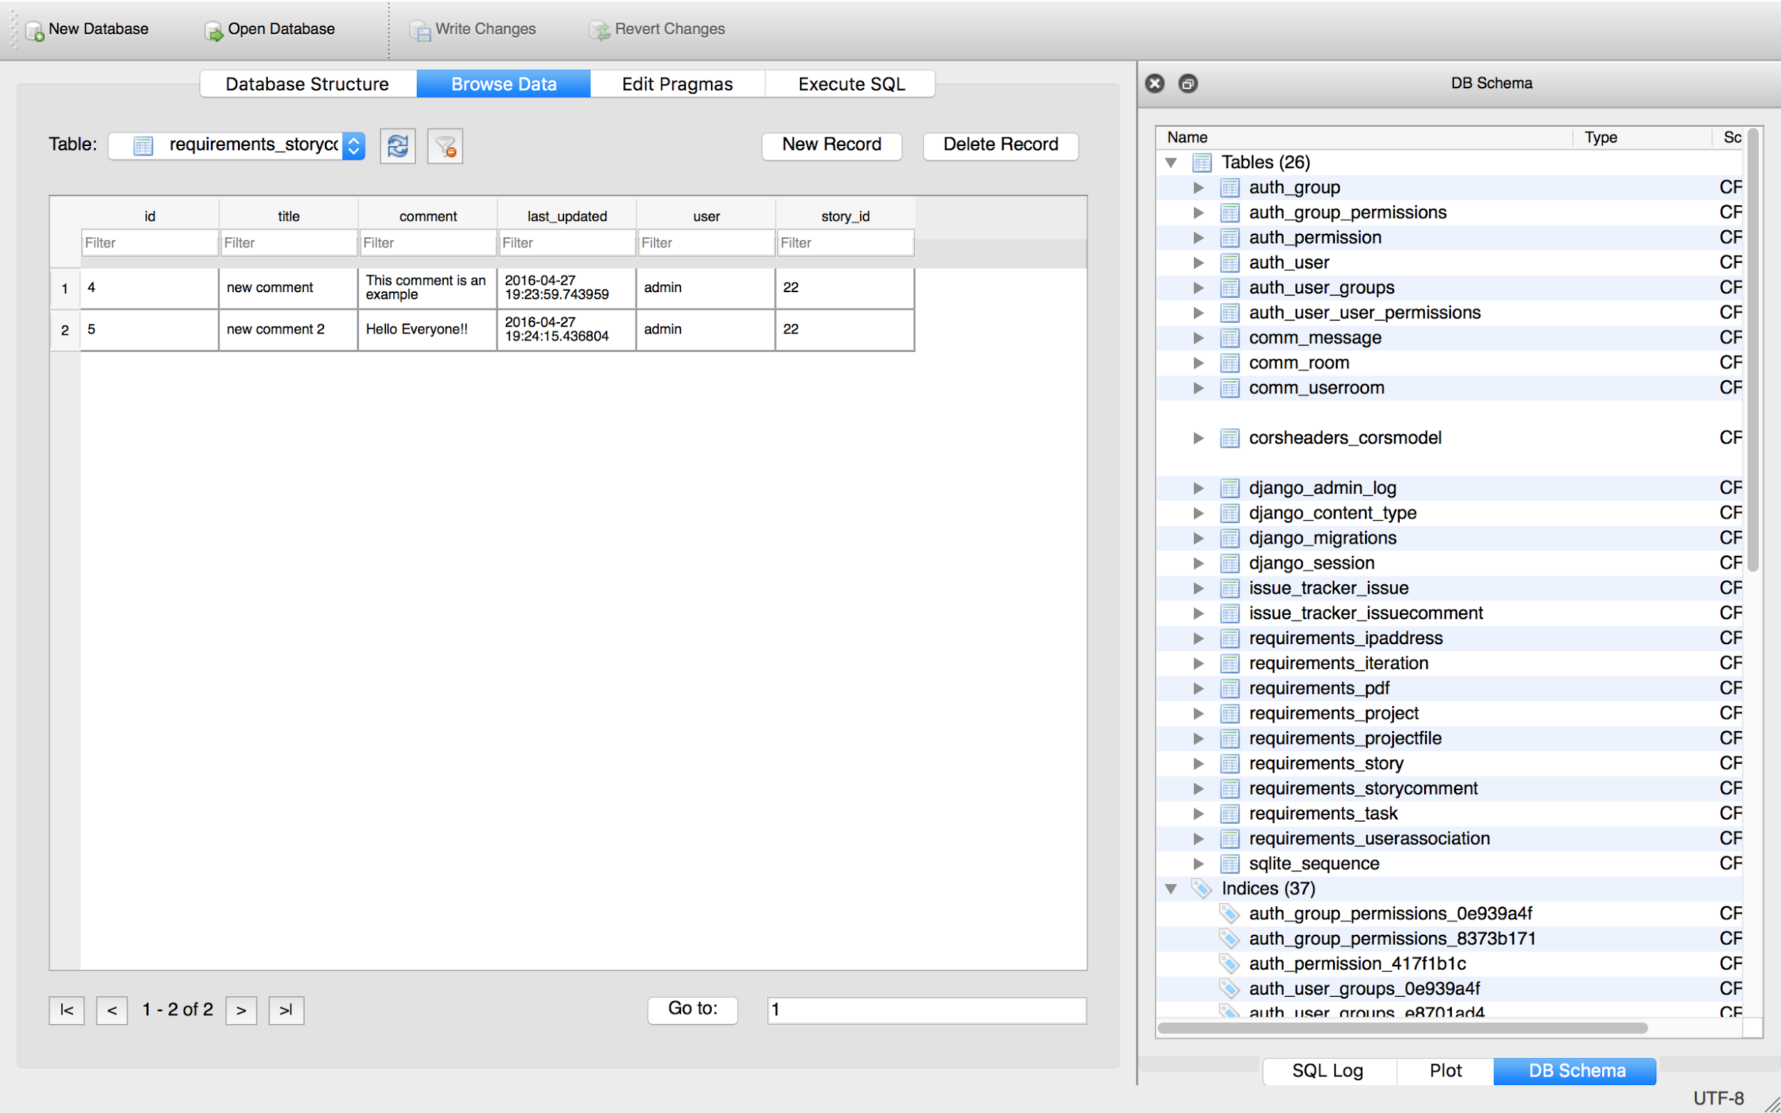

Slide 40
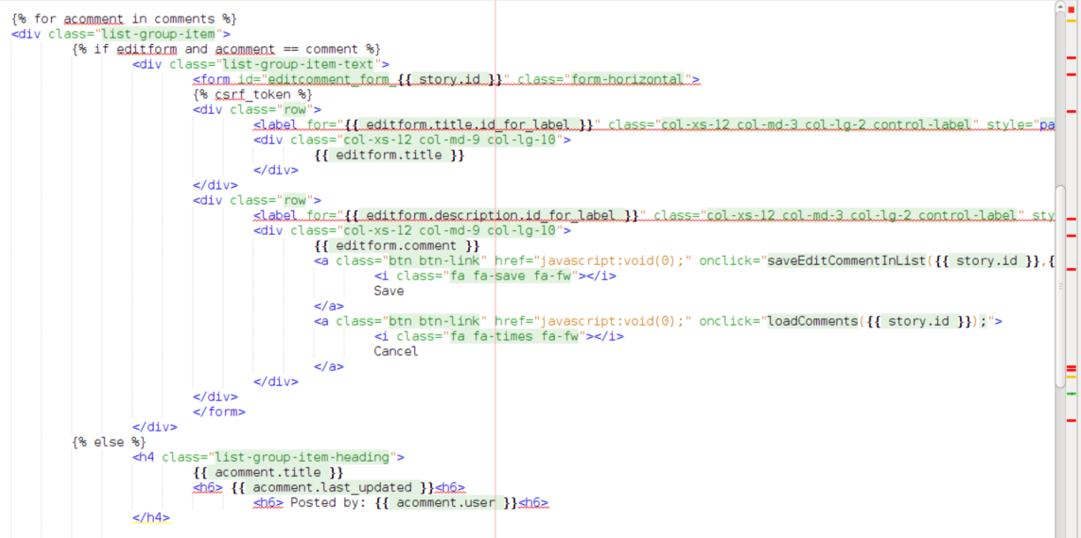

Slide 41

Demo
Group 1
Timeout when no activity for 10 minutes.
Logout automatically when page closed
Role drop down list in sign up page.
User receives emails regarding account changes.

Slide 42
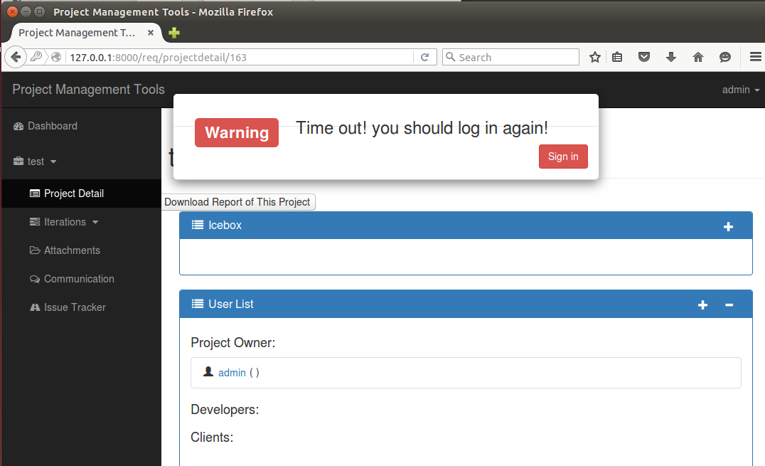

Slide 43

Demo
Group 3
Lock IP Address
Duplicate project name

Slide 44
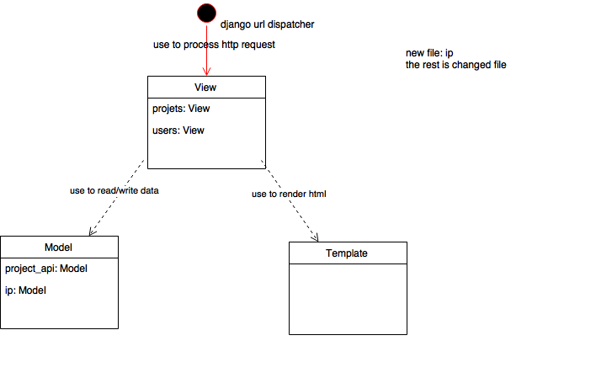
design & implement
changed or new file in MVT

Slide 45
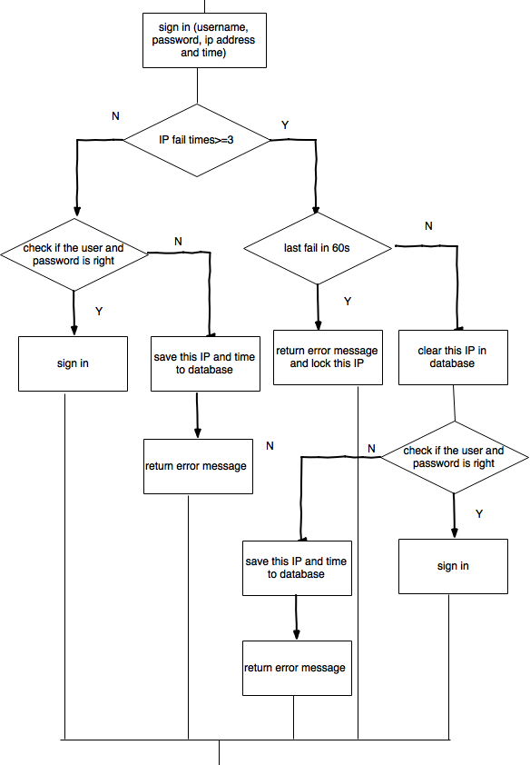
Lock IP address
flow chart

Slide 46

Demo
Group 4
Generate Report -------Simple but Useful!

Slide 47
Group 4
Use Case:
A User could simply select which elements to be included in the project report and then click “Download” to render and generate a project report.
Access Control:
Only project owners and members could generate the project report.

Slide 48
Research
About Collecting the data:
We use several project APIs to collect project data: Project, iterations, stories, tasks.
We also write few APIs to calculate the statistical summary of the project.
We collect all the data instantly and on-the-fly. Fast and write nothing to the database.

Slide 49
Research (from TXT to PDF)
About Rendering the Report:
We did a lot of researches about which PDF renders to use.
Among all, we choose reportLAB to use, which has a lot of documentations as references.
ReportLAB is also open-source and use XML-like language to control the template of the PDF.
ReportLAB is compatible with python and the render speed is fast.

Slide 50
Structures

Slide 51
Future Ideas
It would be much more interesting if we add D3.js or HighCharts into the tool. But for now it is not necessary since there is not so much data to visualize
We left several APIs to expand the report, such as we could add line charts, time-series charts, etc.
The most interesting part is we left APIs for successors to use to save specific users’ choices as templates so that they could just download their own custom report.

Slide 52
Questions?

